Slide 1

Introduction To Object-Oriented Programming
Chapter 12 – A Ship that Fires Bullets

Slide 2
Object-Oriented Programming (OOP)
Let’s build a game called Alien Invasion. We’ll use Pygame, a collection of fun, powerful Python modules that manage graphics, animation, and even sound, making it easier for you to build sophisticated games.
With Pygame handling tasks like drawing images to the screen, you can focus on the higher-level logic of game dynamics.

Slide 3
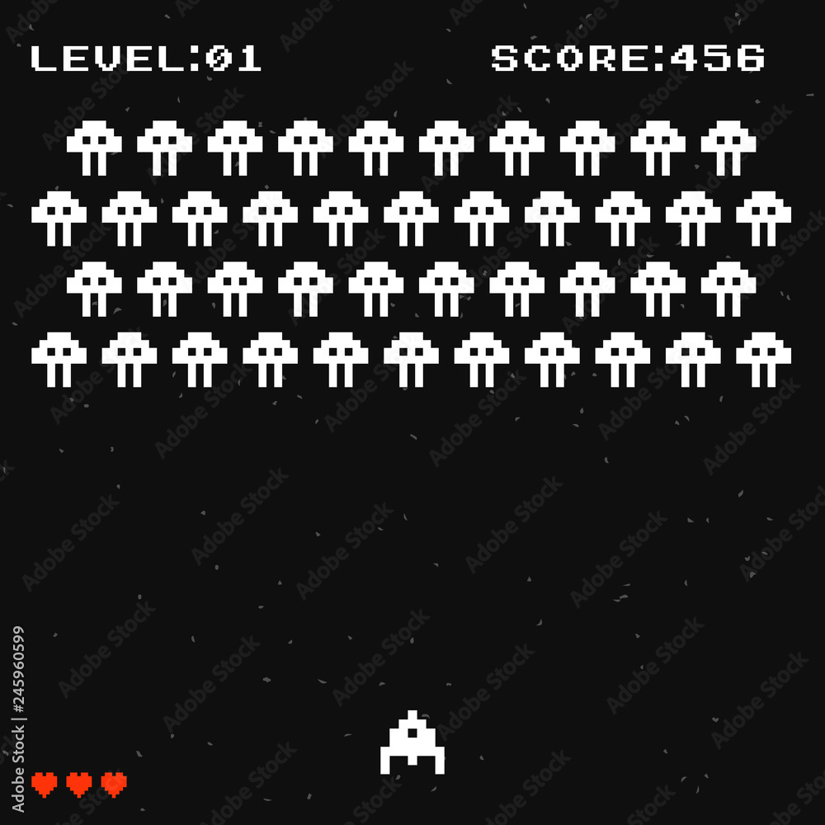
Planning Your Project
When you’re building a large project, it’s important to prepare a plan before you begin to write code. Your plan will keep you focused and make it more likely that you’ll complete the project. Let’s write a description of the general gameplay:

Slide 4
Planning Your Project
In Alien Invasion, the player controls a rocket ship that appears at the bottom center of the screen.
The player can move the ship right and left using the arrow keys and shoot bullets using the spacebar.
When the game begins, a fleet of aliens fills the sky and moves across and down the screen.
The player shoots and destroys the aliens. If the player destroys all the aliens, a new fleet appears that moves faster than the previous fleet. If any alien hits the player’s ship or reaches the bottom of the screen, the player loses a ship. If the player loses three ships, the game ends.

Slide 5
Installing Pygame
To install Pygame, enter the following command at a terminal prompt:

Slide 6
Starting the Game Project
We’ll begin building the game by creating an empty Pygame window.
Later, we’ll draw the game elements, such as the ship and the aliens, on this window.
We’ll also make our game respond to user input, set the background color, and load a ship image

Slide 7
Creating a Pygame Window and Responding to User Input
First, we import the sys and pygame modules. The pygame module contains the functionality we need to make a game. We’ll use tools in the sys module to exit the game when the player quits.
Alien Invasion starts as a class called AlienInvasion. In the __init__() method, the pygame.init() function initializes the background settings that Pygame needs to work properly. Then we call pygame.display.set_mode() to create a display window, on which we’ll draw all the game’s graphical elements. The argument (1200, 800) is a tuple that defines the dimensions of the game window, which will be 1,200 pixels wide by 800 pixels high.

Slide 8
Creating a Pygame Window and Responding to User Input
The object we assigned to self.screen is called a surface.
A surface in Pygame is a part of the screen where a game element can be displayed. Each element in the game, like an alien or a ship, is its own surface. The surface returned by display.set_mode() represents the entire game window. When we activate the game’s animation loop, this surface will be redrawn on every pass through the loop, so it can be updated with any changes triggered by user input.

Slide 9
Creating a Pygame Window and Responding to User Input
The game is controlled by the run_game() method. This method contains a while loop that runs continually.
The while loop contains an event loop and code that manages screen updates.
An event is an action that the user performs while playing the game, such as pressing a key or moving the mouse. To make our program respond to events, we write an event loop to listen for events and perform appropriate tasks depending on the kinds of events that occur. The for loop nested inside the while loop is an event loop.

Slide 10
Creating a Pygame Window and Responding to User Input
To access the events that Pygame detects, we’ll use the pygame.event.get() function. This function returns a list of events that have taken place since the last time this function was called.
Any keyboard or mouse event will cause this for loop to run. Inside the loop, we’ll write a series of if statements to detect and respond to specific events. For example, when the player clicks the game window’s close button, a pygame.QUIT event is detected, and we call sys.exit() to exit the game

Slide 11
Creating a Pygame Window and Responding to User Input
The call to pygame.display.flip() tells Pygame to make the most recently drawn screen visible. In this case, it simply draws an empty screen on each pass through the while loop, erasing the old screen so only the new screen is visible.
When we move the game elements around, pygame.display.flip() continually updates the display to show the new positions of game elements and hide the old ones, creating the illusion of smooth movement.

Slide 12
Creating a Pygame Window and Responding to User Input
At the end of the file, we create an instance of the game and then call run_game(). We place run_game() in an if block that only runs if the file is called directly.
When you run this alien_invasion.py file, you should see an empty Pygame window

Slide 13
Controlling the Frame Rate
Ideally, games should run at the same speed, or frame rate, on all systems.
Controlling the frame rate of a game that can run on multiple systems is a complex issue, but Pygame offers a relatively simple way to accomplish this goal. We’ll make a clock, and ensure the clock ticks once on each pass through the main loop. Anytime the loop processes faster than the rate we define, Pygame will calculate the correct amount of time to pause so that the game runs at a consistent rate

Slide 14
Controlling the Frame Rate
After initializing pygame, we create an instance of the class Clock, from the pygame.time module. Then we’ll make the clock tick at the end of the while loop in run_game()
The tick() method takes one argument: the frame rate for the game. Here I’m using a value of 60, so Pygame will do its best to make the loop run exactly 60 times per second.

Slide 15
Setting the Background Color
Pygame creates a black screen by default, but that’s boring. Let’s set a different background color. We’ll do this at the end of the __init__() method
Colors in Pygame are specified as RGB colors: a mix of red, green, and blue. Each color value can range from 0 to 255. The color value (255, 0, 0) is red, (0, 255, 0) is green, and (0, 0, 255) is blue. You can mix different RGB values to create up to 16 million colors
We fill the screen with the background color using the fill() method, which acts on a surface and takes only one argument: a color

Slide 16
Creating a Settings Class
Each time we introduce new functionality into the game, we’ll typically create some new settings as well. Instead of adding settings throughout the code, let’s write a module called settings that contains a class called Settings to store all these values in one place
To make an instance of Settings in the project and use it to access our settings, we need to also modify alien_invasion.py

Slide 17
Creating a Settings Class
We import Settings into the main program file. Then we create an instance of Settings and assign it to self.settings, after making the call to pygame.init(). When we create a screen, we use the screen_width and screen_height attributes of self.settings, and then we use self.settings to access the background color when filling the screen as well.
When you run alien_invasion.py now you won’t yet see any changes, because all we’ve done is move the settings we were already using elsewhere. Now we’re ready to start adding new elements to the screen

Slide 18
Adding the Ship Image
Let’s add the ship to our game. To draw the player’s ship on the screen, we’ll load an image and then use the Pygame blit() method to draw the image. When you’re choosing artwork for your games, be sure to pay attention to licensing.
The safest and cheapest way to start is to use freely licensed graphics that you can use and modify from a website like https:// opengameart.org
Make a folder called images inside your main alien_invasion project folder. Save the file ship.bmp in the images folder.

Slide 19
Creating the Ship Class
After choosing an image for the ship, we need to display it on the screen. To use our ship, we’ll create a new ship module that will contain the class Ship. This class will manage most of the behavior of the player’s ship
Pygame is efficient because it lets you treat all game elements like rectangles (rects), even if they’re not exactly shaped like rectangles. Treating an element as a rectangle is efficient because rectangles are simple geometric shapes. When Pygame needs to figure out whether two game elements have collided, for example, it can do this more quickly if it treats each object as a rectangle

Slide 20
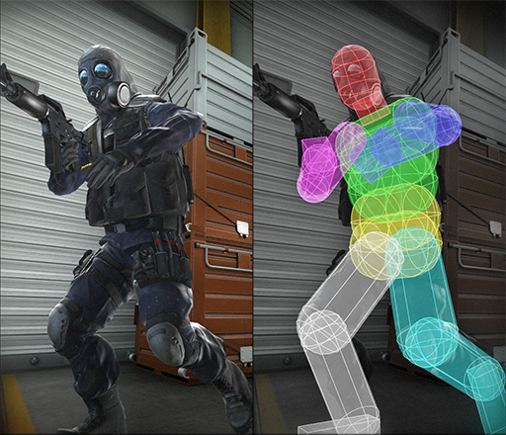
Creating the Ship Class
This approach usually works well enough that no one playing the game will notice that we’re not working with the exact shape of each game element. We’ll treat the ship and the screen as rectangles in this class.

Slide 21
Drawing the Ship to the Screen
Now let’s update alien_invasion.py so it creates a ship and calls the ship’s blitme() method
We import Ship and then make an instance of Ship after the screen has been created . The call to Ship() requires one argument: an instance of AlienInvasion. The self argument here refers to the current instance of AlienInvasion. This is the parameter that gives Ship access to the game’s resources, such as the screen object. We assign this Ship instance to self.ship.
After filling the background, we draw the ship on the screen by calling ship.blitme(), so the ship appears on top of the background.
When you run alien_invasion.py now, you should see an empty game screen with the rocket ship sitting at the bottom center

Slide 22
Refactoring: The _check_events() and _update_screen() Methods
In large projects, you’ll often refactor code you’ve written before adding more code. Refactoring simplifies the structure of the code you’ve already written, making it easier to build on.
In this section, we’ll break the run_game() method, which is getting lengthy, into two helper methods.
A helper method does work inside a class but isn’t meant to be used by code outside the class. In Python, a single leading underscore indicates a helper method

Slide 23
The _check_events() Method
We’ll move the code that manages events to a separate method called _check_events(). This will simplify run_game() and isolate the event management loop. Isolating the event loop allows you to manage events separately from other aspects of the game, such as updating the screen.

Slide 24
The _update_screen() Method
We moved the code that draws the background and the ship and flips the screen to _update_screen(). Now the body of the main loop in run_game() is much simpler. It’s easy to see that we’re looking for new events, updating the screen, and ticking the clock on each pass through the loop.
If you’ve already built a number of games, you’ll probably start out by breaking your code into methods like these. But if you’ve never tackled a project like this, you probably won’t know exactly how to structure your code at first. This approach gives you an idea of a realistic development process: you start out writing your code as simply as possible, and then refactor it as your project becomes more complex.

Slide 25
Piloting the Ship
Next, we’ll give the player the ability to move the ship right and left. We’ll write code that responds when the player presses the right or left arrow key.
We’ll focus first on movement to the right, and then we’ll apply the same principles to control movement to the left. As we add this code, you’ll learn how to control the movement of images on the screen and respond to user input

Slide 26
Responding to a Keypress
Whenever the player presses a key, that keypress is registered in Pygame as an event. Each event is picked up by the pygame.event.get() method. We need to specify in our _check_events() method what kinds of events we want the game to check for.
Each keypress is registered as a KEYDOWN event. When Pygame detects a KEYDOWN event, we need to check whether the key that was pressed is one that triggers a certain action. For example, if the player presses the right arrow key, we want to increase the ship’s rect.x value to move the ship to the right

Slide 27
Responding to a Keypress
When you run alien_invasion.py now, the ship should move to the right one pixel every time you press the right arrow key. That’s a start, but it’s not an efficient way to control the ship. Let’s improve this control by allowing continuous movement

Slide 28
Allowing Continuous Movement
When the player holds down the right arrow key, we want the ship to continue moving right until the player releases the key. We’ll have the game detect a pygame.KEYUP event so we’ll know when the right arrow key is released; then we’ll use the KEYDOWN and KEYUP events together with a flag called moving_right to implement continuous motion.
When the moving_right flag is False, the ship will be motionless. When the player presses the right arrow key, we’ll set the flag to True, and when the player releases the key, we’ll set the flag to False again

Slide 29
Allowing Continuous Movement
The Ship class controls all attributes of the ship, so we’ll give it an attribute called moving_right and an update() method to check the status of the moving_right flag. The update() method will change the position of the ship if the flag is set to True.
We’ll call this method once on each pass through the while loop to update the position of the ship.

Slide 30
Allowing Continuous Movement
Now we need to modify _check_events() so that moving_right is set to True when the right arrow key is pressed and False when the key is released
Here, we modify how the game responds when the player presses the right arrow key: instead of changing the ship’s position directly, we merely set moving_right to True. Then we add a new elif block, which responds to KEYUP events. When the player releases the right arrow key (K_RIGHT), we set moving_right to False

Slide 31
Allowing Continuous Movement
Next, we modify the while loop in run_game() so it calls the ship’s update() method on each pass through the loop
The ship’s position will be updated after we’ve checked for keyboard events and before we update the screen. This allows the ship’s position to be updated in response to player input and ensures the updated position will be used when drawing the ship to the screen.
When you run alien_invasion.py and hold down the right arrow key, the ship should move continuously to the right until you release the key

Slide 32
Moving Both Left and Right
Now that the ship can move continuously to the right, adding movement to the left is straightforward.
In __init__(), we add a self.moving_left flag. In update(), we use two separate if blocks, rather than an elif, to allow the ship’s rect.x value to be increased and then decreased when both arrow keys are held down. This results in the ship standing still. If we used elif for motion to the left, the right arrow key would always have priority. Using two if blocks makes the movements more accurate when the player might momentarily hold down both keys when changing directions

Slide 33
Moving Both Left and Right
We have to make two additions to _check_events()
If a KEYDOWN event occurs for the K_LEFT key, we set moving_left to True. If a KEYUP event occurs for the K_LEFT key, we set moving_left to False. We can use elif blocks here because each event is connected to only one key. If the player presses both keys at once, two separate events will be detected.
When you run alien_invasion.py now, you should be able to move the ship continuously to the right and left. If you hold down both keys, the ship should stop moving

Slide 34
Adjusting the Ship’s Speed
Currently, the ship moves one pixel per cycle through the while loop, but we can take finer control of the ship’s speed by adding a ship_speed attribute to the Settings class. We’ll use this attribute to determine how far to move the ship on each pass through the loop
We set the initial value of ship_speed to 1.5. When the ship moves now, its position is adjusted by 1.5 pixels (rather than 1 pixel) on each pass through the loop
We’re using a float for the speed setting to give us finer control of the ship’s speed when we increase the tempo of the game later on. However, rect attributes such as x store only integer values, so we need to make some modifications to Ship

Slide 35
Adjusting the Ship’s Speed
Now when we change the ship’s position in update(), the value of self.x is adjusted by the amount stored in settings.ship_speed. After self.x has been updated, we use the new value to update self.rect.x, which controls the position of the ship.
Only the integer portion of self.x will be assigned to self.rect.x, but that’s fine for displaying the ship. Now we can change the value of ship_speed, and any value greater than 1 will make the ship move faster

Slide 36
Limiting the Ship’s Range
At this point, the ship will disappear off either edge of the screen if you hold down an arrow key long enough. Let’s correct this so the ship stops moving when it reaches the screen’s edge. We do this by modifying the update() method in Ship
This code checks the position of the ship before changing the value of self.x. The code self.rect.right returns the x-coordinate of the right edge of the ship’s rect. If this value is less than the value returned by self.screen_rect.right, the ship hasn’t reached the right edge of the screen. This ensures the ship is within these bounds before adjusting the value of self.x

Slide 37
Refactoring _check_events()
The _check_events() method will increase in length as we continue to develop the game, so let’s break _check_events() into two separate methods: one that handles KEYDOWN events and another that handles KEYUP events.
We make two new helper methods: _check_keydown_events() and _check _keyup_events(). Each needs a self parameter and an event parameter. The _check_events() method is simpler now with this cleaner code structure, which will make it easier to develop further responses to player input.

Slide 38
Pressing Q to Quit
Now that we’re responding to keypresses efficiently, we can add another way to quit the game. It gets tedious to click the X at the top of the game window to end the game every time you test a new feature, so we’ll add a keyboard shortcut to end the game when the player presses Q
In _check_keydown_events(), we add a new block that ends the game when the player presses Q. Now, when testing, you can press Q to close the game instead of using your cursor to close the window

Slide 39
A Quick Recap
In the next section, we’ll add the ability to shoot bullets, which involves adding a new file called bullet.py and making some modifications to some of the files we’re already using. Right now, we have three files containing a number of classes and methods.
To be clear about how the project is organized, let’s review each of these files before adding more functionality

Slide 40
A Quick Recap: alien_invasion.py
The main file, alien_invasion.py, contains the AlienInvasion class. This class creates a number of important attributes used throughout the game: the settings are assigned to settings, the main display surface is assigned to screen, and a ship instance is created in this file as well. The main loop of the game, a while loop, is also stored in this module. The while loop calls _check_events(), ship.update(), and _update_screen(). It also ticks the clock on each pass through the loop.
The _check_events() method detects relevant events, such as keypresses and releases, and processes each of these types of events through the methods _check_keydown_events() and _check_keyup_events(). For now, these methods manage the ship’s movement. The AlienInvasion class also contains _update _screen(), which redraws the screen on each pass through the main loop.

Slide 41
A Quick Recap: settings.py
The settings.py file contains the Settings class. This class only has an __init__() method, which initializes attributes controlling the game’s appearance and the ship’s speed

Slide 42
A Quick Recap: ship.py
The ship.py file contains the Ship class. The Ship class has an __init__() method, an update() method to manage the ship’s position, and a blitme() method to draw the ship to the screen. The image of the ship is stored in ship.bmp, which is in the images folder.

Slide 43
Shooting Bullets
Now let’s add the ability to shoot bullets.
We’ll write code that fires a bullet, which is represented by a small rectangle, when the player presses the spacebar.
Bullets will then travel straight up the screen until they disappear off the top of the screen

Slide 44
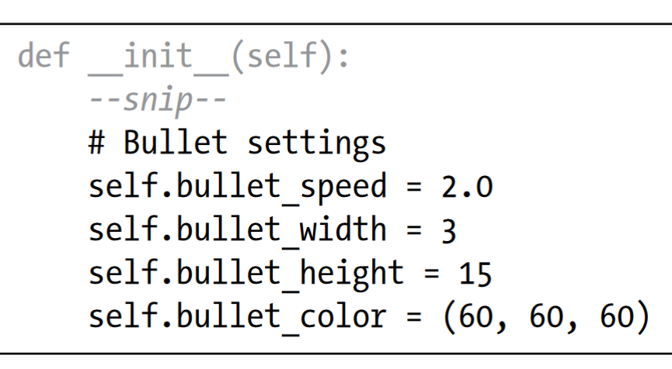
Adding the Bullet Settings
At the end of the __init__() method, we’ll update settings.py to include the values we’ll need for a new Bullet class
These settings create dark gray bullets with a width of 3 pixels and a height of 15 pixels. The bullets will travel slightly faster than the ship.

Slide 45
Creating the Bullet Class
Now create a bullet.py file to store our Bullet class
The Bullet class inherits from Sprite, which we import from the pygame.sprite module. When you use sprites, you can group related elements in your game and act on all the grouped elements at once.
To create a bullet instance, __init__() needs the current instance of AlienInvasion, and we call super() to inherit properly from Sprite. We also set attributes for the screen and settings objects, and for the bullet’s color.

Slide 46
Creating the Bullet Class
Next we create the bullet’s rect attribute. The bullet isn’t based on an image, so we have to build a rect from scratch using the pygame.Rect() class.
This class requires the x- and y-coordinates of the top-left corner of the rect, and the width and height of the rect. We initialize the rect at (0, 0), but we’ll move it to the correct location in the next line, because the bullet’s position depends on the ship’s position. We get the width and height of the bullet from the values stored in self.settings.

Slide 47
Creating the Bullet Class
We set the bullet’s midtop attribute to match the ship’s midtop attribute.
This will make the bullet emerge from the top of the ship, making it look like the bullet is fired from the ship. We use a float for the bullet’s y-coordinate so we can make fine adjustments to the bullet’s speed
The update() method manages the bullet’s position. When a bullet is fired, it moves up the screen, which corresponds to a decreasing y-coordinate value. To update the position, we subtract the amount stored in settings.bullet_speed from self.y. We then use the value of self.y to set the value of self.rect.y

Slide 48
Creating the Bullet Class
The bullet_speed setting allows us to increase the speed of the bullets as the game progresses or as needed to refine the game’s behavior. Once a bullet is fired, we never change the value of its x-coordinate, so it will travel vertically in a straight line even if the ship moves.
When we want to draw a bullet, we call draw_bullet(). The draw.rect() function fills the part of the screen defined by the bullet’s rect with the color stored in self.color

Slide 49
Storing Bullets in a Group
Now that we have a Bullet class and the necessary settings defined, we can write code to fire a bullet each time the player presses the spacebar.
We’ll create a group in AlienInvasion to store all the active bullets so we can manage the bullets that have already been fired. This group will be an instance of the pygame.sprite.Group class, which behaves like a list with some extra functionality that’s helpful when building games.
We’ll use this group to draw bullets to the screen on each pass through the main loop and to update each bullet’s position.

Slide 50
Storing Bullets in a Group
First, we’ll import the new Bullet class. Next we’ll create the group that holds the bullets in __init__(). Then we need to update the position of the bullets on each pass through the while loop
When you call update() on a group, the group automatically calls update() for each sprite in the group. The line self.bullets.update() calls bullet.update() for each bullet we place in the group bullets

Slide 51
Firing Bullets
In AlienInvasion, we need to modify _check_keydown_events() to fire a bullet when the player presses the spacebar. We don’t need to change _check_keyup_events() because nothing happens when the spacebar is released.
We also need to modify _update_screen() to make sure each bullet is drawn to the screen before we call flip().
There will be a bit of work to do when we fire a bullet, so let’s write a new method, _fire_bullet(), to handle this work

Slide 52
Firing Bullets
We call _fire_bullet() when the spacebar is pressed. In _fire_bullet(), we make an instance of Bullet and call it new_bullet. We then add it to the group bullets using the add() method. The add() method is similar to append(), but it’s written specifically for Pygame groups.
The bullets.sprites() method returns a list of all sprites in the group bullets. To draw all fired bullets to the screen, we loop through the sprites in bullets and call draw_bullet() on each one. We place this loop before the line that draws the ship, so the bullets don’t start out on top of the ship.
When you run alien_invasion.py now, you should be able to move the ship right and left and fire as many bullets as you want

Slide 53
Deleting Old Bullets
At the moment, the bullets disappear when they reach the top, but only because Pygame can’t draw them above the top of the screen. The bullets actually continue to exist; their y-coordinate values just grow increasingly negative. This is a problem because they continue to consume memory and processing power.
We need to get rid of these old bullets, or the game will slow down from doing so much unnecessary work. To do this, we need to detect when the bottom value of a bullet’s rect has a value of 0, which indicates the bullet has passed off the top of the screen

Slide 54
Deleting Old Bullets
When you use a for loop with a list (or a group in Pygame), Python expects that the list will stay the same length as long as the loop is running.
That means you can’t remove items from a list or group within a for loop, so we have to loop over a copy of the group.
We use the copy() method to set up the for loop, which leaves us free to modify the original bullets group inside the loop. We check each bullet to see whether it has disappeared off the top of the screen. If it has, we remove it from bullets.
We insert a print() call to show how many bullets currently exist in the game and verify they’re being deleted when they reach the top of the screen

Slide 55
Deleting Old Bullets
If this code works correctly, we can watch the terminal output while firing bullets and see that the number of bullets decreases to zero after each series of bullets has cleared the top of the screen.
After you run the game and verify that bullets are being deleted properly, remove the print() call. If you leave it in, the game will slow down significantly because it takes more time to write output to the terminal than it does to draw graphics to the game window

Slide 56
Limiting the Number of Bullets
Many shooting games limit the number of bullets a player can have on the screen at one time; doing so encourages players to shoot accurately. We’ll do the same in Alien Invasion.
First, store the number of bullets allowed in settings.py. This limits the player to three bullets at a time. We’ll use this setting in AlienInvasion to check how many bullets exist before creating a new bullet in _fire_bullet()
When the player presses the spacebar, we check the length of bullets. If len(self.bullets) is less than three, we create a new bullet. But if three bullets are already active, nothing happens when the spacebar is pressed.
When you run the game now, you should only be able to fire bullets in groups of three

Slide 57
Creating the _update_bullets() Method
We want to keep the AlienInvasion class reasonably well organized, so now that we’ve written and checked the bullet management code, we can move it to a separate method.
We’ll create a new method called _update_bullets() and add it just before _update_screen()
The code for _update_bullets() is cut and pasted from run_game(); all we’ve done here is clarify the comments.

Slide 58
Creating the _update_bullets() Method
Now our main loop contains only minimal code, so we can quickly read the method names and understand what’s happening in the game.
The main loop checks for player input, and then updates the position of the ship and any bullets that have been fired. We then use the updated positions to draw a new screen and tick the clock at the end of each pass through the loop.

Slide 59
Summary
In this chapter, you learned to make a plan for a game and learned the basic structure of a game written in Pygame.
You learned to set a background color and store settings in a separate class where you can adjust them more easily.
You saw how to draw an image to the screen and give the player control over the movement of game elements.
You created elements that move on their own, like bullets flying up a screen, and you deleted objects that are no longer needed.
You also learned to refactor code in a project on a regular basis to facilitate ongoing development.

